Slide 1
Elasticity of Demand

Slide 2
Learning Objective:
To be able to explain the concept of price elasticity of demand
Learning Outcomes:
Outcome 1: Define price elasticity of demand | 😊 | 😐 | 😕
Outcome 2: Explain different types of PED | 😊 | 😐 | 😕
Outcome 3: Calculate PED | 😊 | 😐 | 😕

Slide 3
Price Elasticity of Demand
Price Elasticity of demand is the measure of the responsiveness of qty demanded to a change in Price.
Formula = % change in quantity demanded/ % change in price.
as we know that an increase in price will contract the demand for a product and vice versa.
But how much the demand will contract or extend for a certain change in price.
Businesses and governments are interested to know the effect of the change in price on demand for their decisions.

Slide 4
Elastic/ Inelastic Demand
When change in price leads to greater change in qty demanded, good or service is said to have elastic demand. The percentage change in qty is greater than the percentage change in price it is said that demand is price elastic. PED>1
When change in price leads to smaller change in qty demanded, good or service is said to be price inelastic.
PED<1

Slide 5
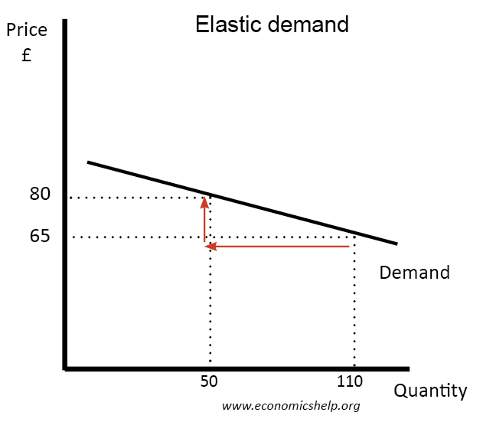
Elastic Demand

Slide 6
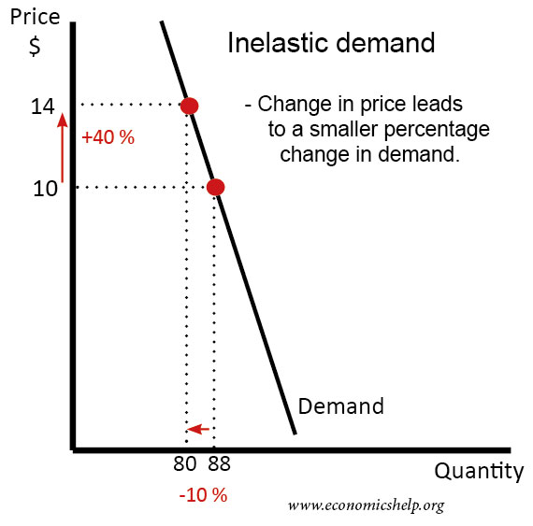
In elastic Demand

Slide 7
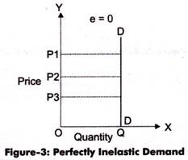
Perfectly Inelastic Demand
Perfectly inelastic curve ( PED= 0)
Rise or fall in the product causes no change in the quantity demanded of that product and hence demand is perfectly price inelastic.

Slide 8
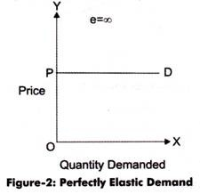
PERFECTLY ELASTIC DEMAND
Infinitely price Elastic – PED is infinite
If product is demanded at one particular price demand is said to be perfectly elastic. It means buyers purchase as much as they possibly can at Price P. It means at a certain price demand is infinite. Perfect elastic demand means that quantity demanded will increase to infinity when the price decreases, and quantity demanded will decrease to zero when price increases.

Slide 9
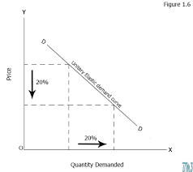
Unitary Elastic Demand
When change in price leads to equal changes in qty demanded. this means that the percentage change in demand is exactly equal to the percentage change in price. PED=1

Slide 10
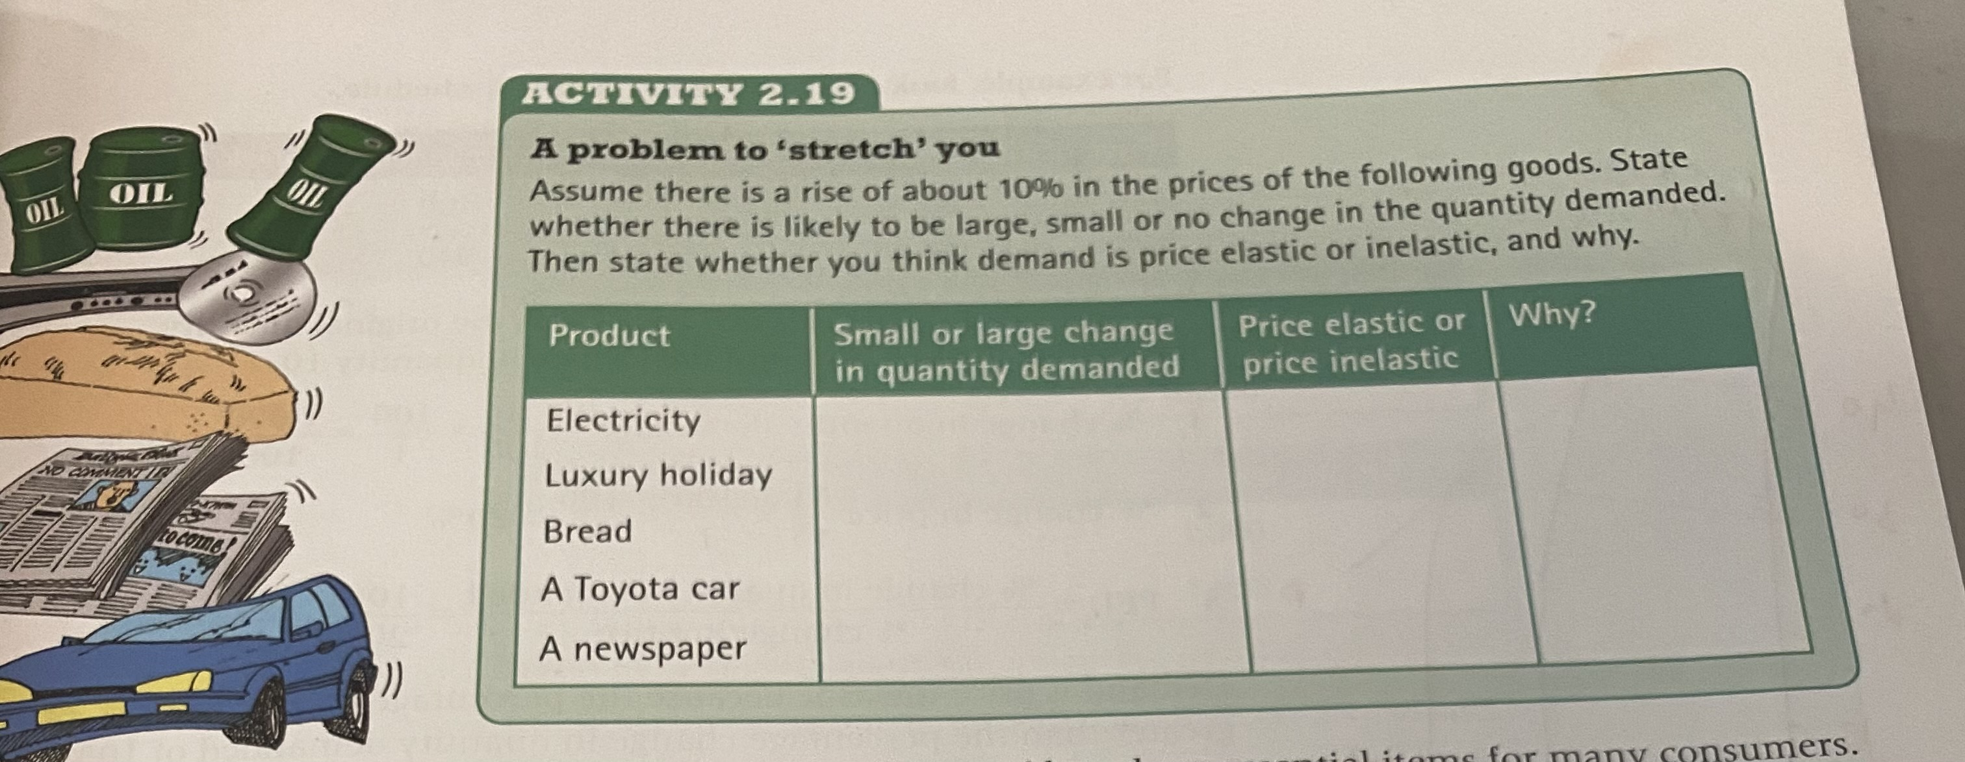

Slide 11
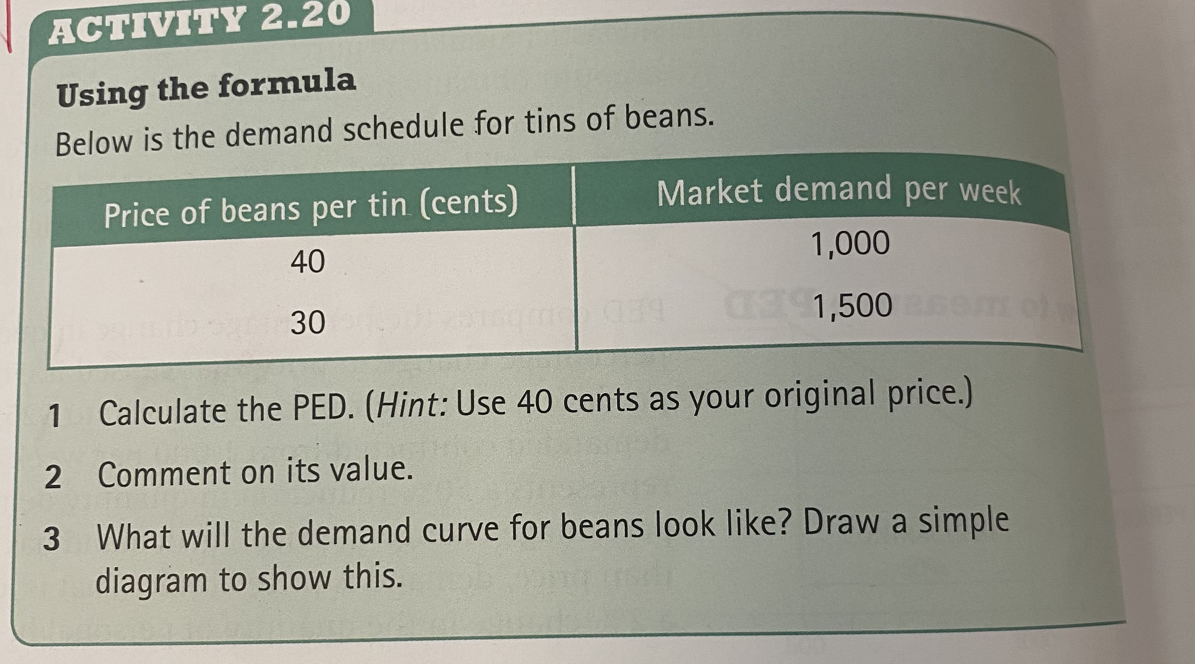

Slide 12
Learning Objective:
To be able to explain the factors influencing PED
Learning Outcomes:
Explain the factors
Analyse the importance of PED to the firms and government
Calculate TR

Slide 13
Total Revenue and the Price Elasticity of Demand
Total revenue is the amount paid by buyers and received by sellers of a good.
Computed as the price of the good times the quantity sold.

Slide 14
Importance of Price elasticity of demand
Helps to calculate revenue
If the demand is price elastic then a minor change in increasing the price will reduce the level of revenue. By how much amount revenue will fall depends upon the degree of elasticity.
Always Remember-
In case of goods which are elastic, firms will reduce prices to increase profits.
In case of goods which are inelastic, firms will increase prices to increase profits

Slide 15
Elasticity of a Linear Demand Curve
Price
Demand is elastic; demand is responsive to changes in price.
$7
Elasticity is > 1 in this range.
6
5
4
Elasticity is < 1 in this range.
3
Demand is inelastic; demand is not very responsive to changes in price.
2
When price increases from $2 to $3, TR increases from $20 to $24.
1
0
2
4
6
8
10
12
14
Quantity

Slide 16
Factors determining the price Elasticity of demand
Availability of substitutes of a similar quality and price.
Proportion of Income spent on a product
Necessary or Luxury
Time period under consideration
Addictive or non addictive
Can purchase of a product be postponed.

Slide 17
SUMMARY
Price elasticity of demand measures how much the quantity demanded responds to changes in the price.
Price elasticity of demand is calculated as the percentage change in quantity demanded divided by the percentage change in price.
  If a demand curve is elastic, total revenue falls when the price rises.
  If it is inelastic, total revenue rises as the price rises.

Slide 18
Price Elasticity of supply.
Price Elasticity of supply is the measure of responsiveness of quantity supplied to a change in price.
Es = % change in quantity supplied / % change in price.
If the percentage change in price is greater than the percentage change in supply, supply is said to be price inelastic and the value of price elasticity of supply will be less than 1 .
If the percentage change in price causes a much larger change in quantity supplied, supply is said to be price elastic and price elasticity of supply will be greater than 1.

Slide 19
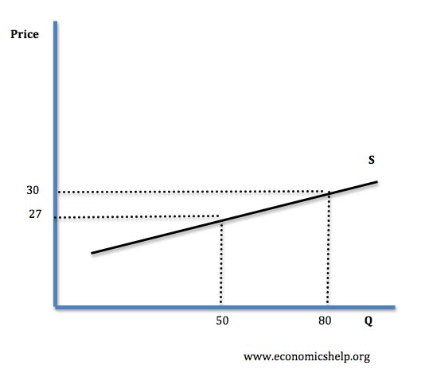
Elastic Supply
When changes in price lead to greater changes in qty supplied. PES>1

Slide 20
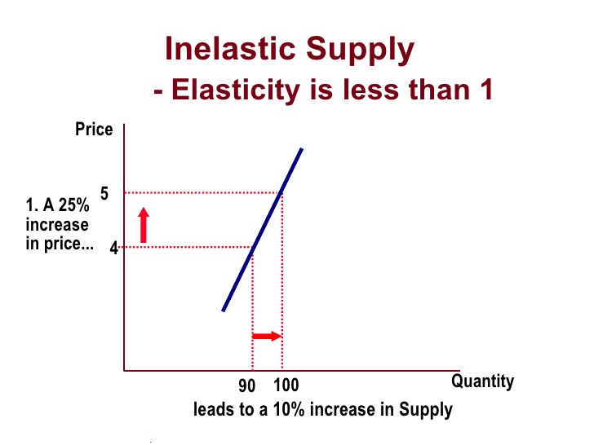
Inelastic Supply
Change in price results to smaller changes in qty supplied. PES<1

Slide 21
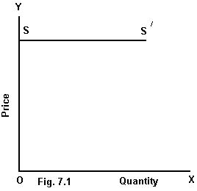
Perfectly elastic supply
A perfectly elastic supply curve is horizontal meaning that producers are prepared to supply any amount at a given price. The value is infinite.
The PES for perfectly elastic supply is infinite, where the quantity supplied is unlimited at a given price, but no quantity can be supplied at any other price.

Slide 22
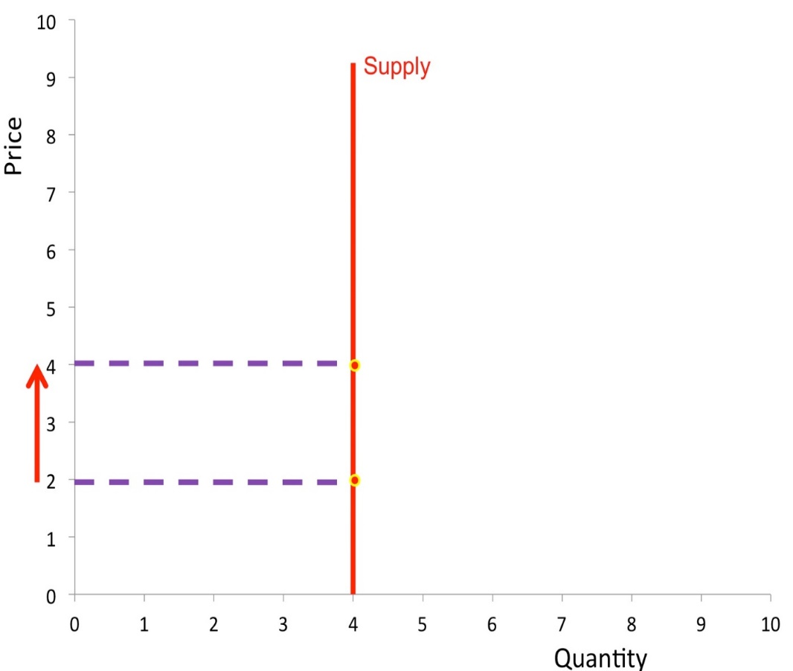
Perfectly inelastic supply
A perfectly inelastic supply curve means that a a price change will not affect supply at all and that is supply is fixed and the value is zero.

Slide 23
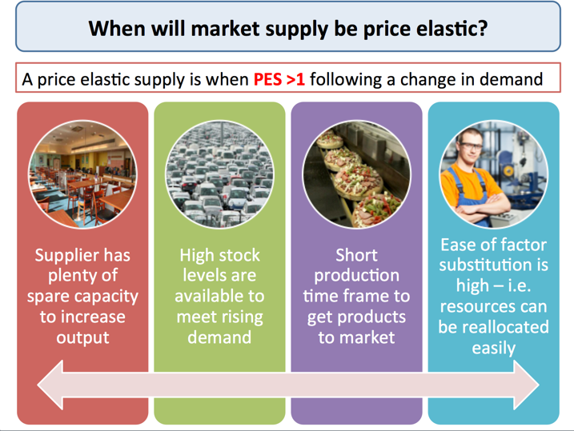

Slide 24
Factors affecting price Elasticity of supply
Spare production capacity: If there is plenty of spare capacity then a business can increase output without a rise in costs and supply will be elastic in response to a change in demand. The supply of goods and services is most elastic during a recession, when there is plenty of spare labour and capital resources.
Stocks of finished products and components: If stocks of raw materials and finished products are at a high level then a firm is able to respond to a change in prices quickly and supply will be elastic.

Slide 25
The ease and cost of factor substitution/mobility: If both capital and labour are occupationally mobile then the elasticity of supply for a product is higher than if capital and labour cannot easily be switched. E.g. a printing press which can switch easily between printing magazines and greetings cards.
Time period and production speed: Supply is more price elastic the longer the time period that a firm is allowed to adjust its production levels. In some agricultural markets the momentary supply is fixed and is determined mainly by planting decisions made months before, and also climatic conditions, which affect the production yield..

Slide 26
Learning Objective:
To be able to explain the impact of indirect taxes on producers and consumers
Learning Outcomes:
Define indirect taxes
Describe specific tax and percentage tax
Explain the incidence of tax on consumers and producers based on PED
Extension: Illustrate consumer burden, producer burden and govt revenue on D & S diagram.

Slide 27
Incidences of Taxes and Subsidies.
Taxes are placed on goods and services and these are known as Indirect taxes, for eg values added tax (ad valorem tax), excise duties, custom duties which are placed on cigarettes and alcohol. These have the effect of increasing market price and reducing the quantity traded in the market.
In terms of the graph the supply curve shifts to the left and the vertical distance between the curves ( new and Old) shows the amount of tax.

Slide 28
Indirect taxes
Indirect taxes are those imposed by a government on goods and services, in contrast to direct taxes, such as income and corporation tax, which are levied on incomes of households and firms. Indirect taxes are also called expenditure taxes.
The purpose of indirect taxes is to:
Generate tax revenue for a government
Discourage consumption of ‘harmful’ products
Encourage consumption of ‘good’ products

Slide 29
Specific and ad valorem taxes
There are two types of indirect tax; specific and ad valorem.
A unit tax is a set amount of tax per unit sold, such as a 10p tax on packets of cigarettes.
The imposition of either type of indirect tax has an effect similar to a rise in production costs. This means that a firm's supply curve will shift up vertically by the amount of the tax.
A specific unit tax
A specific unit tax will shift up the supply curve by the full amount of the tax, so that the new curve is parallel to the original one, as shown, below because the tax is a fixed amount for each unit of output.

Slide 30
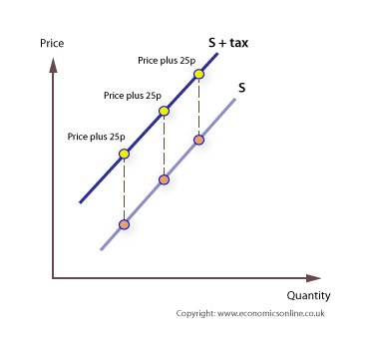

Slide 31
The incidence of a tax on cigarettes - an example
If the government puts an extra tax of £1.00 on each packet of cigarettes, the legal incidence is on the cigarette smoker. However, the local market may be very competitive, with many sellers, so that a retailer may fear they will suffer from lost sales, and decide to put up the price by only 50p, and pay the balance of 50p to the government themselves. In this case, the economic incidence is shared because both are worse off. The smoker is worse off because of the price increase of 50p, and the seller is worse off because 50p must come out of their revenue to pay the government.

Slide 32
The effect of price elasticity of demand
In most cases, the burden is split between producers and consumers and both parties are worse off. The key to whether the consumer or producer carries the burden is the extent to which the tax can be passed on to the consumer in terms of higher prices.
In the diagram below the incidence on the consumer is indicated by the price rise, P to P1, times the new quantity sold, 0 to Q1. However, the vertical distance is the tax per unit, which is greater than the price rise, hence the incidence on the producer is measured as the distance P to X, times 0 to Q1 - the green shaded area. The precise division depends upon how consumers react to a price rise, that is, their price elasticity of demand.

Slide 33
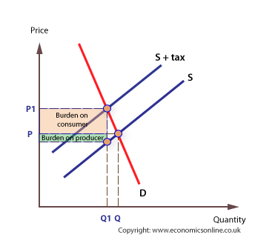
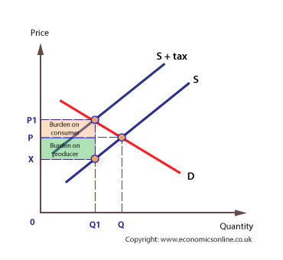

Slide 34
Explanation of the diagram consumer Burden & for producer Burden.
The Market is at equilibruim at P and Q.
As a tax is imposed the supply curve shifts to the left by the amount of the tax.
Prices will increase to P1 ( what the consumer now pays for the product.)
Quantity demanded contracts to Q1. producers get a lower price of p2 as they pay only a part of the tax.
Consumer Burden is the increase in price paid by the consumers.
Producer Burden is the burden which the producer will bear .
Revenue will be PB plus CB

Slide 35
Learning Objective:
To be able to explain impact of subsidies and percentage tax
Learning Outcome:
Define percentage tax and subsidies
Explain the impact of subsidies
Illustrate subsidies on D & S graph

Slide 36
Percentage Tax
An ad valorem tax
The imposition of an ad valorem tax will shift up the supply curve by a certain percentage, meaning that the new supply curve will not be parallel to the original. With the advalorem tax the new supply curve will be steeper than the specific tax because the tax is calculated as a percentage of price, that is the amount of tax per unit increases as price increases.

Slide 37
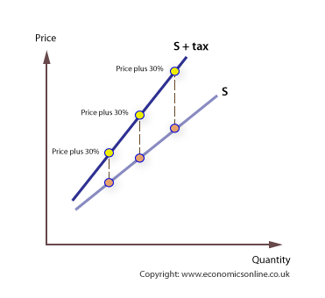

Slide 38
Subsidies
A subsidy is an incentive given by the government to individuals or businesses in the form of cash, grants that improve the supply of certain Goods and Services.
The subsidy causes the firm's supply curve to shift to the right since COP reduces as a result of the subsidy.

Slide 39
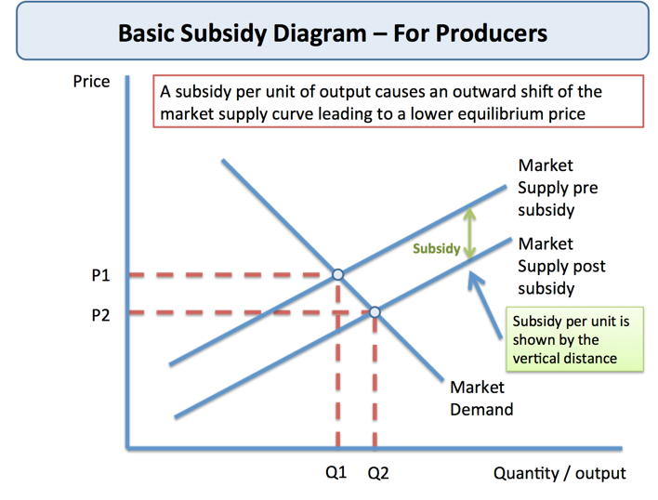

Slide 40
Evaluation of subsidies
Advantages:
Used in agriculture to support farmers
Encourage innovation
Used to encourage production and lower cost of solar panels and turbines
Disadvantages:
Cause excess supply
Distort international competition

